Slide 1



Data entry in DHIS2
Introduction to DHIS2

Slide 2



Notes:
If we want to make informed, data-driven decisions that have an impact on people, we first need to understand how those data are captured and verified.
Only when we have reliable data, can we trust in our analysis to support decision making.

Slide 3




In this video, you will see…
Next video…
Data entry
Data quality
Notes:
In this video, you will see how data are entered into DHIS2. In the next video, you’ll find out how DHIS2 helps ensure data quality.

Slide 4








Centralized data warehouse
Direct entry
Other data sources
SMS
API
Notes:
DHIS2 works as a centralized data warehouse capable of capturing data from a number of different sources and devices including direct entry through the web or an android device, SMS and even other data sources such as spreadsheets or other electronic systems.

Slide 5

Categories of data in DHIS2
Data Models
123
Numerical
Anonymous individualized
Individual with identifiers
Notes:
Within the DHIS2 platform, there are several data collection tools that we can use depending on the type of data we want to capture.
We can distinguish 3 broad categories of data in DHIS2, also known as data models:
Numerical or aggregate data
Anonymous individualized data, and
Individual data with identifiers.
Let's briefly review each of these models.

Slide 6
Numerical or agregate data
Aggregate
Data entry app
123
Numerical
Notes:
The first data model is numerical or aggregate data and we use the Data Entry app to capture data of this type.

Slide 7




Example of aggregate data capture
10
Immunization program
Notes:
For example, let's say 10 children received their vaccines today in a given health facility in the context of an immunization program, and we want to enter this information into DHIS2.

Slide 8




Example of aggregate data capture
10
Immunization program
Notes:
What are the steps we need to follow to enter these data?
Let's go to the platform and see how it works.

Slide 9
DEMO 1
Notes:
After logging in, we go to the application's icon in DHIS2 and open the Data Entry app. Then, we search the facility from the dropdown menu, select the immunization program from the Data Set menu, followed by the time period we want to update.
To enter the data, you only need to select the cell and update the numbers.
DEMO

Slide 10
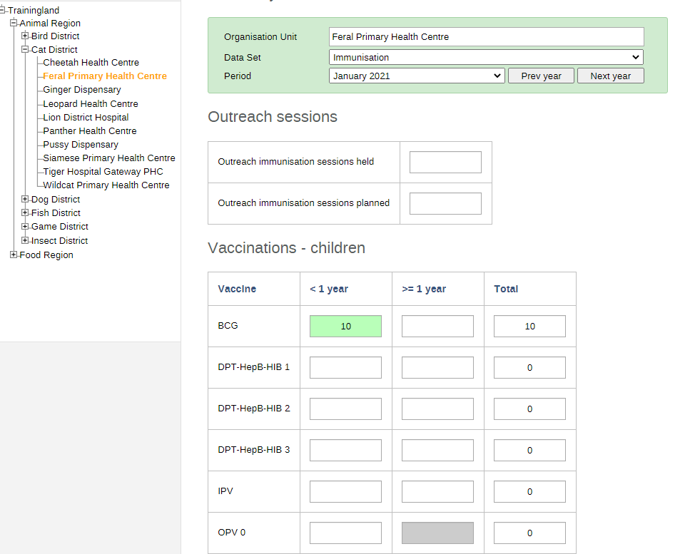
Hierarchy
Form
Notes:
Note that forms, as well as the configuration and hierarchy of the health system are completely customizable within the platform. This will be discussed further later on.

Slide 11

Anonymous individualized data - Events
Events
Capture App
Anonymous individualized
Notes:
The second category of data, or data model, captures anonymous individualized data, also called Events, and we use the Capture app to register Event data.

Slide 12

Example of event data capture
Notes:
For example, let's say we want to register a new COVID 19 case in a given health facility,
What are the steps to enter this Event data in DHIS2?
Let's go back to the platform.

Slide 13
DEMO 2
Notes:
In this case, we select the Capture app from the application's icon. Then, we need to search for the facility, and select the program, in this case, COVID-19 Cases (events), and then click on New Event.
Once you fill out the form, the data is stored in DHIS2.
DEMO

Slide 14


Event data are anonymous
Events
Capture App
Anonymous
Follow-up
Notes:
Note that when entering events, the data you are capturing is anonymous, as follow-up on individual cases is not possible within this model.

Slide 15

Individual data with identifiers - Tracker
Tracker
Tracker Capture App
Individual with identifiers
Notes:
The third type of data is individual data with identifiers that can be tracked over time. This is also know as the Tracker data model
We use the Tracker Capture app to register and enter those data.

Slide 16
Individual data with identifiers - Tracker
Tracker Capture App
Name
Phone number
Any other identifier
Notes:
Using this data model, it's possible to identify a person by their name, phone number, or a combination of any other identifiers.

Slide 17







Tracker: follow-up on individuals
Follow-up
Notes:
We use this model when we want to follow up on individuals to track their services and perform individual-level management of cases.

Slide 18

Example of tracker capture
Notes:
For example, let's say we want to register a patient with COVID-19 to facilitate disease surveillance.
What steps should we follow to enter these data?

Slide 19
DEMO 3
Notes:
As in the previous examples, we go to the application's icon and, in this case, open the Tracker capture app, then search for the facility, select the program, and click on "Register."
The form contains data that allow identify the individuals and track the services they receive.
DEMO

Slide 20
Summary
Data Models
123
Aggregate
Anonymous individualized
Individual with identifiers
Numerical
Events
Tracker
Data Entry App
Capture App
Tracker Capture App
Notes:
To wrap up, there are three broad categories of data, or data models, in DHIS2:
Numerical or aggregate data
Anonymous individualized data or Events, and
Individual data with identifiers, or, the Tracker data model.
And, for each one, there is a specific entry tool:
Data entry for aggregate data
The capture app for Events,
And the Tracker capture app, for Tracker data.

